Slide 1
Automatic detection of invasive ductal carcinoma in whole slide images with CNN
Research Hypothesis-
By using different visual property based global feature extractors specifically color based feature extractors along with the usage of deep neural networks would increase the recall score by at least five percent as compared to the existing CNN recall score.
Team R&D
Ravi Singh 12159093
Dhruv Sharma 76749332
Notes:
Speciﬁcity (Spc), or true negative rate, is deﬁned as the proportion of Non-IDC regions correctly predicted from total actual Non-IDC regions = (TN / TN + FP)

Slide 2
Why!
Histopathological Image Analysis?
The analysis of histopathological image is done manually by a pathologist and therefore the diagnosis is subjective and greatly dependent on the level of expertise of the professional.
Colour based feature extractors?
More representative of how a pathologist visually identifies IDC at lower resolutions.
Tissue Morphological features like nuclear texture and nuclear architecture are more important in distinguishing between different grades of IDC.
Our analysis is only limited to identify a patch containing IDC or not.

Slide 3
Colour Spaces
YUV - Common in image and video compression.
It is half the size of RGB and can be processed twice as fast using CNN.
HSV is hue, saturation and Value. HSV is derived from RGB colour space. HSV rearranges the geometry of RGB in an attempt to be more intuitive and perceptually relevant.
RGB - The RGB colour model is used on Computer Monitors and Television screens to produce the colour that the user will see when using the system.
Expected Results : Since the ground truth annotations were done by a human pathologist, expecting to see that RGB performs best. Also image loses information when converted to other colour spaces.

Slide 4
Where is the Data!
162 Women diagnosed with IDC at the Hospital of University of Pennsylvania and the Cancer Institute of New Jersey. Dataset available on Kaggle Link.
Whole Slide Images were digitised with a whole slide scanner at 40X magnification.
Train Patches - 161909
Validation Patches - 49581
Test Patches – 66034
Class Balance Ratio – IDC : Non IDC :: 3 : 1

Slide 5
Pre processing
Data Augmentation done using Keras Image Data Generator function.
Horizontal Flips, Zoom Range, Shear Range
Skimage Image equalisation - Histogram equalizing makes images have a uniform histogram.
Exposure function
Parameter Tuning
Decay/ Regularization – 0.007
Learning Rate – 0.01
Optimiser – Stochastic Gradient Descent

Slide 6
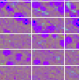
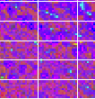
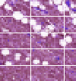
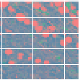
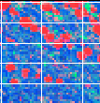
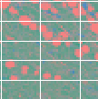
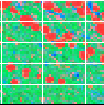
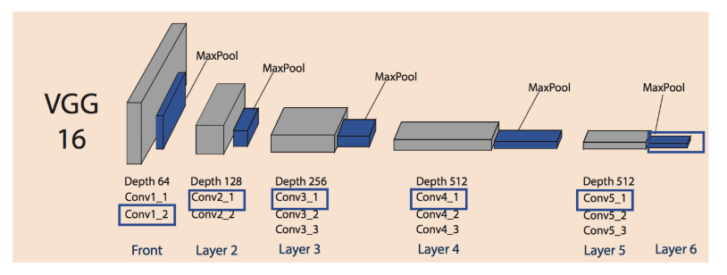
HSV
Equalised HSV
IDC
IDC
Non - IDC
Original 50 X 50
YUV
Equalised YUV
Non - IDC
YCRCB
Equalised YCRCB
C1 16 (5X5) – S2 (2X2) – C2 32 (5X5) – S2 (2X2) – C3 128 (5X5) – S3 (2X2) - D1 128 - D2 64 – D3 2
Pre Processing
Convolutions
3 Convolutions 2D
Sub sampling
3 Max pooling 2D
Full Connected Layer
Sigmoid Binary Classifier
IDC
IDC
Non - IDC

Slide 7
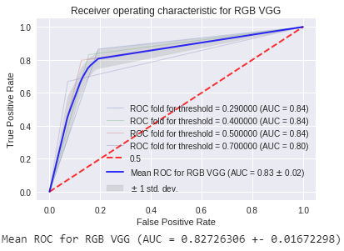
Performance Metrics
Recall – TP / TP + FN where,
TP = Patches having IDC and detected correctly.
FN = Patches having IDC but not detected correctly.
Recall is the proportion of IDC correctly predicted from whole IDC automatically predicted.
Model assessment done using Confusion Matrix
using testing data and Classification Report.
Thresholds – 0.29, 0.4, 0.5, 0.7 . Best results at 0.29
Recall
Accuracy
F1 =2 * ((Pr * Rc) / (Pr + Rc))
ROC Curves

Slide 8
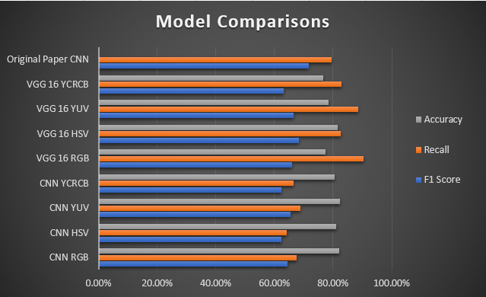

Slide 9
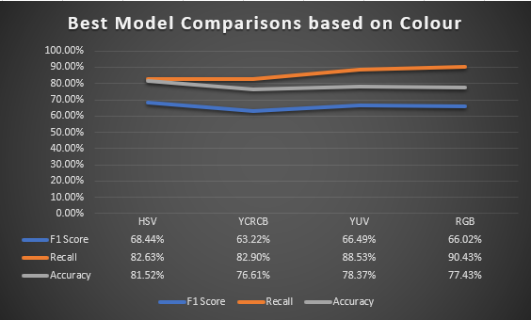

Slide 10
Hypothesis validation
Increase of 11.55% in Recall score when comparing best model to original CNN Recall score.
Increase of 9.5% in Recall score when compared best VGG 16 YUV model against original model which was also in YUV.
RGB and YUV CNN and VGG 16 models performed better as compared to other colour feature extractors.
Statistics Link.

